Slide 1
Dapper
A Tech talk challenge

Slide 2
Overview
What is Dapper?
ORM and micro-ORM frameworks
Difference between ORM and micro-ORM
5 Ws of Dapper
Dapper vs EF Core Performance
Demo
Prototype

Slide 3
What is Dapper?
micro ORM
simple object mapper framework which helps to map the native query output to a domain class or a C# class
a high performance data access system built by StackOverflow team and released as open source
Notes:
Object-Relational Mapping (ORM) is a technique that lets you query and manipulate data from a database using an object-oriented paradigm. When talking about ORM, most people are referring to a library that implements the Object-Relational Mapping technique, hence the phrase "an ORM".
An ORM library is a completely ordinary library written in your language of choice that encapsulates the code needed to manipulate the data, so you don't use SQL anymore; you interact directly with an object in the same language you're using.
Stack Overflow is the largest, most trusted online community for developers to learn, share​ ​their programming ​knowledge, and build their careers.

Slide 4
Some of ORM Frameworks
Java - Ebean, open-source ORM framework, EJB
.NET – Dapper, Entity Framework, Linq to SQL
Python - Django
PHP - CakePHP
Ruby - DataMapper
Notes:
Ebean is an object-relational mapping product written in Java. It is designed to be simpler to use and understand than JPA (Java Persistence API) or JDO (Java Data Objects) products.
LINQ to SQL is a component of .NET Framework version 3.5 that provides a run-time infrastructure for managing relational data as objects.
Django is a high-level Python Web framework that encourages rapid development and clean, pragmatic design. Built by experienced developers, it takes care of much of the hassle of Web development, so you can focus on writing your app without needing to reinvent the wheel. It’s free and open source.
CakePHP is an open-source web, rapid development framework that makes building web applications simpler, faster and require less code.
DataMapper is a library that lets you work with your database from object-oriented code.

Slide 5
List of micro-ORM Frameworks
Major – Dapper and PetaPOCO
Massive
Mighty
Notes:
PetaPOCO - Like Dapper, it's fast because it uses dynamic method generation (MSIL) to assign column values to properties
An ORM library is a completely ordinary library written in your language of choice that encapsulates the code needed to manipulate the data, so you don't use SQL anymore; you interact directly with an object in the same language you're using.
Massive - It's a small MicroORM based on the Expando or dynamic type and allows you to work with your database with almost no effort. The design is based on the idea that the code provided to you in this repository is a start: you get up and running in no-time and from there edit and alter it as you see fit.
Mighty - A new small, happy, dynamic micro-ORM and general purpose .NET data access wrapper.

Slide 6
Difference between ORM and micro-ORM
Dapper falls into a family of tools known as micro-ORMs
only a subset of the functionality of full-blown Object Relations Mappers
Dapper concentrates its efforts on the O and M of ORM - Object Mapping
 | Micro ORM | ORM
Map queries to objects | ✓ | ✓
Caching results | ✗ | ✓
Change tracking | ✗1 | ✓
SQL generation | ✗2 | ✓
Identity management | ✗ | ✓

Slide 7
Difference between ORM and micro-ORM…
[1] Some extensions have been added to Dapper that provide minimal change tracking capability
[2] Dapper actually does generate SQL, but in a limited fashion
 | Micro ORM | ORM
Association management | ✗ | ✓
Lazy loading | ✗ | ✓
Unit of work support | ✗ | ✓
Database migrations | ✗ | ✓

Slide 8
5 Ws of Dapper
Stackoverflow developed it as micro-ORM
Performance and ease of use is of greater value
Easily execute queries (scalar, multi-rows, multi-grids, and no-results)
Dapper is available from Nuget.
extremely lightweight and simple to use
Who develop Dapper?
When to use Dapper?
What does Dapper actually do?
Where can you get Dapper?
Why use Dapper?
Notes:
The original developers of Dapper were using Entity Framework Core's predecessor - the short-lived Linq to SQL. They found that query performance wasn't good enough for the increasing traffic that the site in question (Stackoverflow) was experiencing, so they wrote their own micro ORM.
It is a high performance data access system built by StackOverflow team and released as open source. If your project prefers writing stored procedures or writing native query instead of using a full-fledged ORM tools like EntityFramework or NHibernate then Dapper is obvious choice for you. Using Dapper, it is very easy to fire a SQL query against database and get the result mapped to C# domain class.

Slide 9
Entity Framework vs Dapper?
EF Advantages
Dapper advantages
allows you to create a model by writing code or using boxes and lines in the EF Designer and generate a new database.
the system will automatically produce objects for you as well as track changes on those objects and simplify the process of updating the database.
Makes it easy to correctly parameterize queries
It can easily execute queries (scalar, multi-rows, multi-grids, and no-results)
Make it easy to turn results into objects
It is very efficient and owns the title of King of Micro ORM in terms of performance.

Slide 10
Entity Framework vs Dapper? (cont…)
EF Advantages
One common syntax (LINQ) for all object queries whether it is a database or not and pretty fast if used as intended, easy to implement and less coding required to accomplish complex tasks.
The EF can replace a large chunk of code you would otherwise have to write and maintain yourself.
It provides auto-generated code
It reduces development time and cost.
It enables developers to visually design models and mapping of database

Slide 11
Entity Framework vs Dapper? (cont…)
EF DISAdvantages
Dapper DISadvantages
You have to think in a non-traditional way of handling data, not available for every database.
If there is any schema change in database EF won't work and you have to update the schema in solution as well.
The EF queries are generated by the provider that we cannot control.
Dapper can't generate a class model for you
It cannot generate queries for you
It cannot track objects and their changes
The raw dapper library doesn't provide CRUD features, but the "contrib" additional package does provide basic CRUD.

Slide 12
Entity Framework vs Dapper? (cont…)
EF DISAdvantages
It is not good for a huge domain model.
Lazy loading is the main drawbacks of EF

Slide 13
Dapper vs EF Core 2 Benchmark
Reference: https://medium.com/@engr.mmohsin/entity-framework-core-2-dapper-performance-benchmark-c29e8cce9e1b#:~:text=Dapper%20is%20faster%20than%20the,either%20based%20on%20my%20benchmark.

Slide 14
Dapper Demo
AN ASP.NET CORE WEB APP

Slide 15
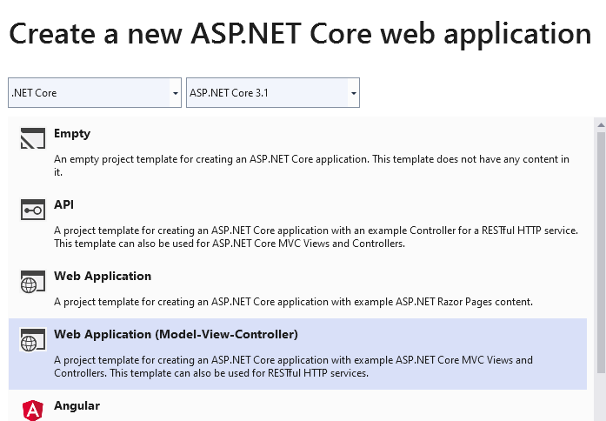
Create an ASP.NET Core Web (MVC)

Slide 16
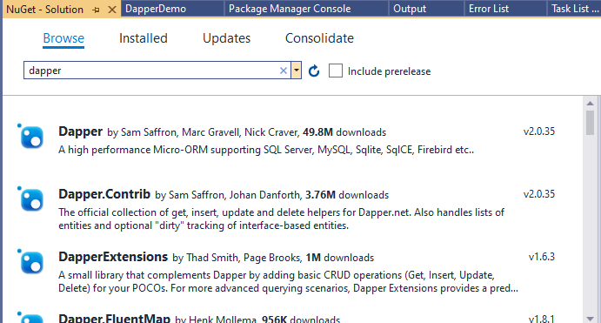
Next, get the Dapper Nuget package installed into the project

Slide 17
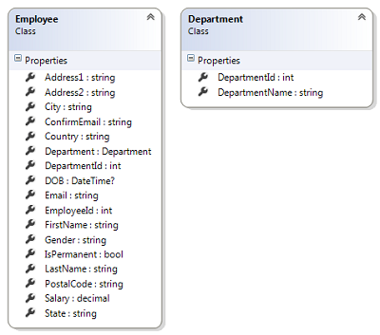
Let’s use a simple Employee-Department model as seen below and use Dapper to do some most commonly used data access query

Slide 18
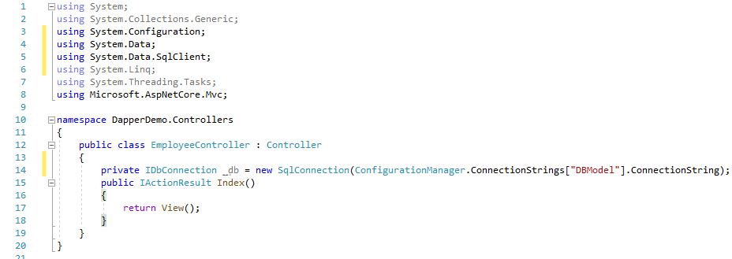
Create EmployeeController class and declare IDbConnection _db with a database connection using the AppSettings connection string below:

Slide 19
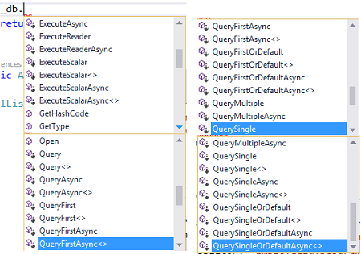
Include System.Data, System.Data.SqlClient and Dapper namespace. You can see all the data access methods when you type _db. in the action method. The below image gives you a quick list of available methods.

Slide 20
1. Let’s now see how to call a stored procedure and return an Employee object from the query result. The below code uses QueryFirstOrDefault() method to execute a stored procedure and return an Employee object.
Employee emp = _db.QueryFirstOrDefault<Employee>("EmployeeGet ", new { EmployeeId = id }, commandType: CommandType.StoredProcedure);
EmployeeGet SP:
CREATE PROCEDURE [dbo].[EmployeeGet]
@EmployeeId INT
AS
SELECT * FROM Employees WHERE EmployeeId = @EmployeeId

Slide 21
Alternatively, you can also execute a query directly using Query() method as seen below.
Employee emp = _db.Query<Employee>("select * from Employees where EmployeeId=@EmployeeId ", new { EmployeeId = id }).FirstOrDefault();

Slide 22
2. To execute a stored procedure with DML queries, we can use Execute() method. The below code executes a stored procedure EmployeeUpdate to update the Employee table row.
_db.Execute("EmployeeUpdate",
FirstName = empModel.FirstName,
LastName = empModel.LastName,
DepartmentId = empModel.DepartmentId,
Address1 = empModel.Address1,
Address2 = empModel.Address2,
City = empModel.City,
State = empModel.State,
Country = empModel.Country,
PostalCode = empModel.PostalCode,
Email = empModel.Email,
ConfirmEmail = empModel.ConfirmEmail,
DOB = empModel.DOB,
Salary = empModel.Salary,
IsPermanent = empModel.IsPermanent,
Gender = empModel.Gender,
EmployeeId = empModel.EmployeeId }, commandType: CommandType.StoredProcedure);

Slide 23
EmployeeUpdate SP:
CREATE PROCEDURE [dbo].[EmployeeUpdate] @EmployeeId INT, @FirstName VARCHAR(50), @LastName VARCHAR(50), @DepartmentId INT, @Address1 VARCHAR(50), @Address2 VARCHAR(50), @City VARCHAR(50), @State VARCHAR(50), @Country VARCHAR(50), @PostalCode VARCHAR(50), @Email VARCHAR(50), @ConfirmEmail VARCHAR(50), @DOB DATETIME, @Gender VARCHAR(50), @IsPermanent BIT, @Salary DECIMAL(9,2) AS UPDATE Employees SET FirstName = @FirstName, LastName = @LastName, DepartmentId = @DepartmentId, Address1 = @Address1, Address2 = @Address2, City = @City, State = @State, Country = @Country, PostalCode = @PostalCode, Email = @Email, ConfirmEmail = @ConfirmEmail, DOB = @DOB, Gender = @Gender, IsPermanent = @IsPermanent, Salary = @Salary WHERE EmployeeId = @EmployeeId

Slide 24
3. Executing a Stored Procedure to return a Complex Object
CREATE PROCEDURE [dbo].[GetEmployeesSummary] AS SELECT EmployeeId, FirstName + ' ' + LastName As Name, d.DepartmentId as DepartmentId, d.DepartmentName as DepartmentName FROM Employees e INNER JOIN Departments d ON e.DepartmentId = d.DepartmentId

Slide 25
The below EmployeeSummary class has Department as child object which can be used to get the result of above stored procedure.
public class EmployeeSummary { public int EmployeeId { get; set; } public string Name { get; set; } public Department Department { get; set; } }

Slide 26
To get the result of the stored procedure as EmployeeSummary object, we can use the below Query<TFirst,TSecond,TReturn>() overload as seen below.
public ActionResult EmployeeSummary() { IList<EmployeeSummary> empSummary = _db.Query<EmployeeSummary, Department, EmployeeSummary>("[GetEmployeesSummary]", (emp, dept) => { emp.Department = dept; return emp; }, splitOn: "EmployeeId,DepartmentId").ToList(); return View(empSummary); }

Slide 27
ProtoType that uses Dapper
Aide cross platform

